Slide 1
Vehicle Speed Controlled Driving System using Wireless Sensor Network
Batch members
1.V.Nirmalkumar
2.K.Lokesh
3.R.HariPrasath
4.P.SureshMenon
Guided by
Prof .T .SOMASSOUNDARAM
Professor & Head

Slide 2
Content
Abstract
Introduction of Embedded System
Existing work
Block Diagram
Block Explanation
Hardware Required
Software Required
Advantage & Disadvantage
Reference

Slide 3
Abstract
In any urban area with public amenities like schools, hospitals, parks , etc. Which see a lot of footfall, there are innumerable cases of accidents happening due to speeding vehicles.
An effective solution we have come up with is a system which will automatically detect and reduce the speed of the vehicles and maintain it under a limit in the specified zone.
This is done by integrating a wireless module in the Electronic Control Unit (ECU), and providing a network for the school/hospital, we WSN create a system that checks the speed of vehicles when in range of the network.
The system in the car is linked to the throttle valve, which in turn will reduce the speed of the vehicle.

Slide 4
Introduction of Embedded System
Embedded systems date back to the 1960s.
Charles Stark Draper developed an integrated circuit (IC) in 1961 to reduce the size and weight of the Apollo Guidance Computer
The digital system installed on the Apollo Command Module and Lunar Module. The first computer to use ICs, it helped astronauts collect real-time flight data.
An embedded system is a combination of computer hardware and software, either fixed in capability or programmable, designed for a specific function or functions within a larger system.
Industrial machines, agricultural and process industry devices, automobiles, medical equipment, cameras, household appliances, airplanes, vending machines and toys, as well as mobile devices, are possible locations for an embedded system.

Slide 5
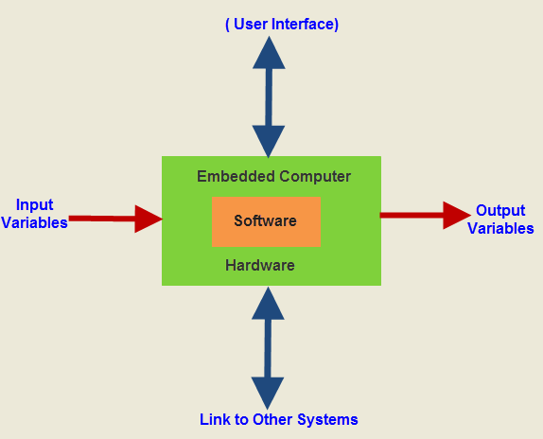

Slide 6
Existing Work
Now day’s vehicles are improving with faster speeds and technological advancements which were attained and annoying more serious accidents.
Automobile manufacturers became more concerned with improving car safety and preventing injuries and deaths. People usually gravitate towards automatic transmission of vehicles because of the simplicity it offers to drivers.
In this paper five safety measures are implemented. Ultrasonic sensors mounted on the front and/or rear bumpers are used for an obstacle detection system.
Ultrasonic sensors measure the distance between driving car and nearby obstacles directly around the front or rear bumper and speed of car will get less. The driver is alerted by beeps or the dashboard display.
The speed of car become low as the vehicle moves closer to the obstacle. Depending on distance of obstacle from car speed will vary. A collision is imminent then car will get stop. A speed limit according to obstacle detection is our first safety measure in this paper.

Slide 7
The second safety measure is for increased engine temperature .If thermostat is broken and water pump gasket failure are reasons of increased engine temperature. If the temperature gets high, it could mean engine is overheating.
It WSN also happen due to losing coolant therefore we need to cool engine by radiator fan. In this paper we turn ON radiator fan automatically if temperature increases beyond normal temperature conditions.
The third safety measure is for seatbelt. A seat belt is safety belt is designed to secure the driver of a vehicle during a collision or a sudden stop as a vehicle safety device. A seat belt is used to reduce the likelihood of death or serious injury in a traffic collision.
Seat belts were not always utilized by its operators. It wasn’t until Congress in many states addressed but this is very serious issue of car safety on a state and national level, to a serious campaign to use the seat belts was launched.
In this paper, to improve car safety notification for use of seat belts that would secure themselves display automatically after ignition on the LCD display.

Slide 8
The fourth safety measure is automatic headlight ON/OFF. During day there is no need of headlights but at night time headlights will get automatically ON.
The person travelling from the opposite direction use high, bright beam while driving at night and therefore experiences a sudden glaring effect for a short period of time. Due to this depending on opposite vehicle's light intensity, headlights of driving car will get dim automatically.
Battery and increased engine temperature are related phenomenon. The ideal operating temperature for an automotive battery is 26.7 C (80 F). This is when the battery operates at maximum efficiency.
Heat typically accelerates chemical activity if battery is getting hot, but higher temperatures also speed up internal corrosion within the cells and reduce the life of the battery.
This is particularly true of batteries that repeatedly reach high internal temperatures, and once capacity has been damaged by heat, it WSN’t be restored. So in this paper car automatically go into power saving mode if battery voltage increases. This is last safety measure in this paper.

Slide 9
Modification
Instead of Controller Area Network (CAN) we are going to use Wireless Sensor Network (WSN).
Instead of IOT we are going to use Zig Bee for avoiding Internet access.
In this project Solar Panel is used for power generation.

Slide 10
Solar Panel
Battery
Battery Power
Division
Zig bee
Rx
Microcontroller
LPC-2148
LCD-Display
Transmitter unit

Slide 11
Power unit
Microcontroller
LPC-2148
Zig bee
Rx
H-bridge motor
devices
Motor 1
Motor 2
Receiver Unit

Slide 12
Peripherals in LPC2148
2 UART(UART 0 & UART 1)
2 TIMER(TIMER 0 &TIMER1)
2 SPI(SERIAL PERIPHERAL INTERFACE)
2 I2I(I2I 0 &I2I 1)
2ADC (ADC 0 & ADC 1 )
2 DAC (DAO & 1 )
PWM
32 BIT MICROCONTROLLER

Slide 13
LPC2148 Microcontroller
UART stands for Universal Asynchronous Receiver/Transmitter. It's not a communication protocol like SPI and I2C, but a physical circuit in a microcontroller, or a stand-alone IC. A UART's main purpose is to transmit and receive serial data
SPI - Serial Peripheral Interface (SPI) is an interface bus commonly used to send data between microcontrollers and small peripherals such as shift registers, sensors, and SD cards. It uses separate clock and data lines, along with a select line to choose the device you wish to talk to.
PWM-Pulse-width modulation (PWM) is a modulation process or technique used in most communication systems for encoding the amplitude of a signal right into a pulse width or duration of another signal, usually a carrier signal, for transmission.
ADC- Stands for "Analog-to-Digital Converter." Since computers only process digital information, they require digital input. Therefore, if an analog input is sent to a computer, an analog-to-digital converter (ADC) is required
DAC takes digital data and transforms it into an analog audio signal. Afterward, it sends that analog signal to an amplifier. When you hear digital recordings, you're actually listening to an analog signal that was converted from digital by a DAC. ... For example, your smart phone contains only a very basic DAC.

Slide 14
Hardware Required
Microcontroller(LPC2148)
Zig bee (Transmitter and Receiver)
H- bridge motor
Power Unit
Battery Power Division
LCD display
Battery
Solar Panel

Slide 15
Software Required
Keil M4 version.
Flash Magic.
Hyper terminal.

Slide 16
Advantage
Controls speed gradually.
Prevents life.
Internet not required.
Works 24/7 with help of green energy.

Slide 17
Disadvantage
Zig bee range upto 100 meters with further research the range can be improved.
Works effectively to the countries have good intensity of sunlight.

Slide 18
Reference
Priyanka A. Wagh, Rohit R. Pawar, Dr.S.L.Nalbalwar, “Vehicle Speed Control and Safety Prototype Using Controller Area Network “2017
Ashwini S.Shinde , Prof.Vidhyadhar and B.Dharmadhikari ,“Controller Area Network for Vehicle automation”, International Journal of Emerging Technology and Advanced Engineering 2012.
Beying Deng and Xufeng Zhang,“Car networking application in vehicle safety”, Workshop on Advanced Research and Technology in Industry Applications, 2014.
Thanima Thulaseedharan, Vijayakumar.K, Nishitha Gerison, “Real Time Intelligent Driver Assistance System ”, International Journal of Engineering Research and General Science Volume 3, Issue 1, January-February, 2015.
M. Santhosh Kumar, PG Scholar and Dr.C.R.Balamurugan,” Self -Propelled Safety System Using CAN Protocol- A Review” ,2016 World Conference on Futuristic Trends in Research and Innovation for Social Welfare (WCFTR’16).

Slide 19
Thank you

